Slide 1
Forward & Backward
Transformations

Slide 2

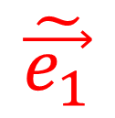



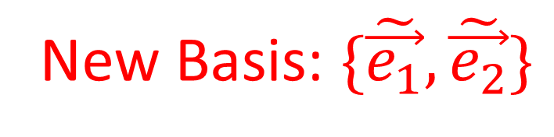

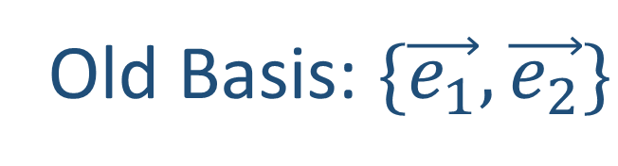
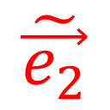
Old Basis: $\{\vec{e_{1}},\vec{e_{2}}\}$
New Basis: $\{\tilde{\vec{e_{1}}},\tilde{\vec{e_{2}}}\}$
$$\vec{e_{2}}$$
$$\tilde{\vec{e_{1}}}$$
$$\tilde{\vec{e_{2}}}$$
$$\vec{e_{1}}$$
$$\vec{n_{i}}=\sum_{j}{F_{ij}\vec{o_{j}}}$$

Slide 3
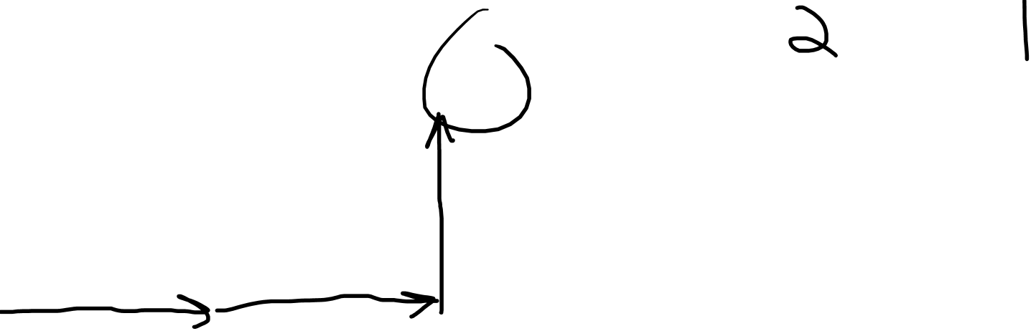
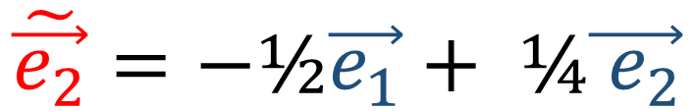

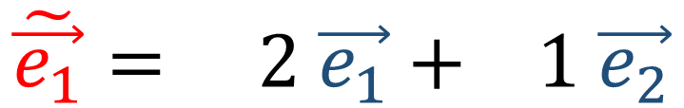
Old Basis: $\{\vec{e_{1}},\vec{e_{2}}\}$
New Basis: $\{\tilde{\vec{e_{1}}},\tilde{\vec{e_{2}}}\}$
$$\vec{e_{2}}$$
$$\tilde{\vec{e_{1}}}= 2 \vec{e_{1}}+ 1 \vec{e_{2}}$$
$$\tilde{\vec{e_{1}}}$$
$$\tilde{\vec{e_{2}}}=−\text{½}\vec{e_{1}}+ \text{¼}\vec{{ e}_{2}}$$
$$\tilde{\vec{e_{2}}}$$
$$\vec{e_{1}}$$
$$F=\left[\begin{matrix}2 & 1 \\ 1 & \text{½}\end{matrix}\right]$$

Slide 4
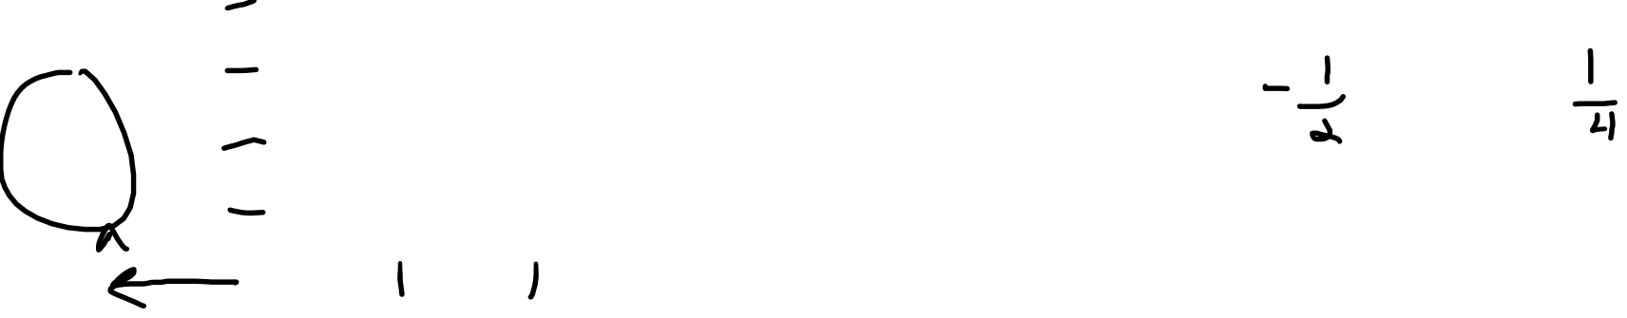
Old Basis: $\{\vec{e_{1}},\vec{e_{2}}\}$
New Basis: $\{\tilde{\vec{e_{1}}},\tilde{\vec{e_{2}}}\}$
$$\vec{e_{2}}$$
$$\tilde{\vec{e_{1}}}= 2 \vec{e_{1}}+ 1 \vec{e_{2}}$$
$$\tilde{\vec{e_{1}}}$$
$$\tilde{\vec{e_{2}}}=−\text{½}\vec{e_{1}}+ \text{¼}\vec{{ e}_{2}}$$
$$\tilde{\vec{e_{2}}}$$
$$\vec{e_{1}}$$
$$F=\left[\begin{matrix}2 & 1 \\ 1 & \text{½}\end{matrix}\right]$$

Slide 5
Old Basis: $\{\vec{e_{1}},\vec{e_{2}}\}$
New Basis: $\{\tilde{\vec{e_{1}}},\tilde{\vec{e_{2}}}\}$
$$\vec{e_{2}}$$
$$\tilde{\vec{e_{1}}}= 2 \vec{e_{1}}+ 1 \vec{e_{2}}$$
$$\tilde{\vec{e_{1}}}$$
$$\tilde{\vec{e_{2}}}=−\text{½}\vec{e_{1}}+ \text{¼}\vec{{ e}_{2}}$$
$$\tilde{\vec{e_{2}}}$$
$$\vec{e_{1}}$$
$$F=\left[\begin{matrix}2 & 1 \\ 1 & \text{½}\end{matrix}\right]$$

Slide 6
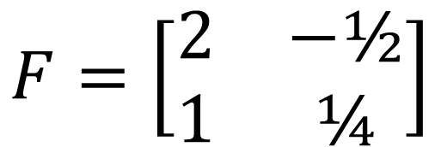
Old Basis: $\{\vec{e_{1}},\vec{e_{2}}\}$
New Basis: $\{\tilde{\vec{e_{1}}},\tilde{\vec{e_{2}}}\}$
$$\vec{e_{2}}$$
$$\tilde{\vec{e_{1}}}= 2 \vec{e_{1}}+ 1 \vec{e_{2}}$$
$$\tilde{\vec{e_{1}}}$$
$$\tilde{\vec{e_{2}}}=−\text{½}\vec{e_{1}}+ \text{¼}\vec{{ e}_{2}}$$
$$\tilde{\vec{e_{2}}}$$
$$\vec{e_{1}}$$
$$F=\left[\begin{matrix}2 & −\text{½} \\ 1 & \text{¼}\end{matrix}\right]$$

Slide 7

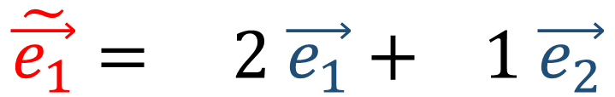
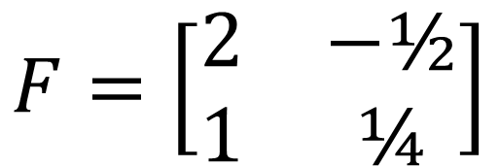
Old Basis: $\{\vec{e_{1}},\vec{e_{2}}\}$
New Basis: $\{\tilde{\vec{e_{1}}},\tilde{\vec{e_{2}}}\}$
$$\tilde{\vec{e_{1}}}= 2 \vec{e_{1}}+ 1 \vec{e_{2}}$$
$$\tilde{\vec{e_{2}}}=−\text{½}\vec{e_{1}}+ \text{¼}\vec{{ e}_{2}}$$
$$F=\left[\begin{matrix}2 & −\text{½} \\ 1 & \text{¼}\end{matrix}\right]$$

Slide 8
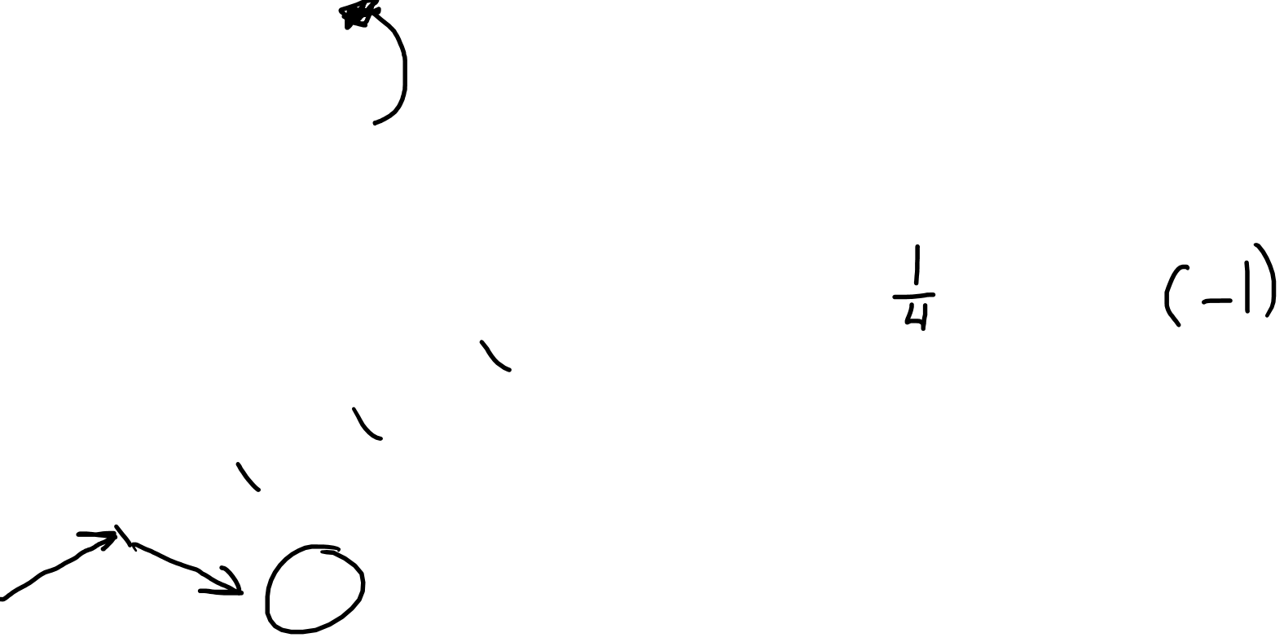
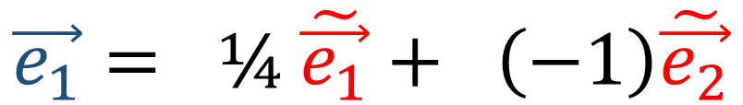
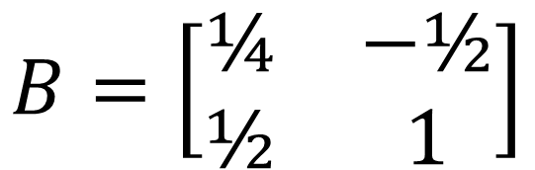
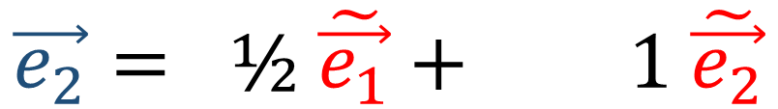
Old Basis: $\{\vec{e_{1}},\vec{e_{2}}\}$
New Basis: $\{\tilde{\vec{e_{1}}},\tilde{\vec{e_{2}}}\}$
$$\vec{e_{2}}$$
$$\vec{e_{1}}= \text{¼} \tilde{\vec{e_{1}}}+ \left(−\text{1}\right)\tilde{\vec{e_{2}}}$$
$$\tilde{\vec{e_{1}}}$$
$$\vec{e_{2}}= \text{½} \tilde{\vec{e_{1}}}+ \text{1} \tilde{\vec{e_{2}}}$$
$$\tilde{\vec{e_{2}}}$$
$$\vec{e_{1}}$$
$$B=\left[\begin{matrix}\text{¼} & −\text{½} \\ \text{½} & \text{1}\end{matrix}\right]$$

Slide 9
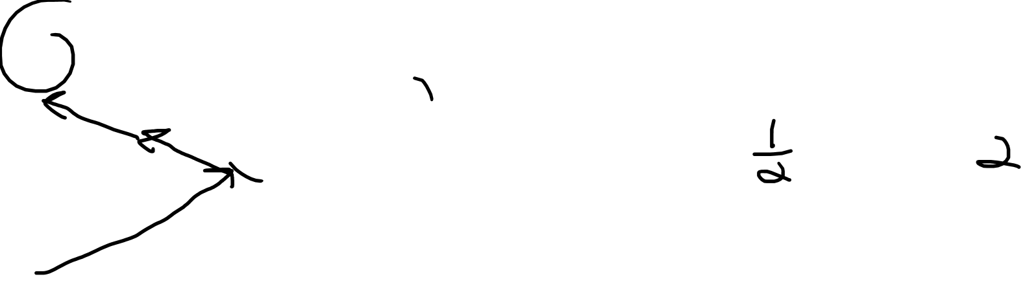
Old Basis: $\{\vec{e_{1}},\vec{e_{2}}\}$
New Basis: $\{\tilde{\vec{e_{1}}},\tilde{\vec{e_{2}}}\}$
$$\vec{e_{2}}$$
$$\vec{e_{1}}= \text{¼} \tilde{\vec{e_{1}}}+ \left(−\text{1}\right)\tilde{\vec{e_{2}}}$$
$$\tilde{\vec{e_{1}}}$$
$$\vec{e_{2}}= \text{½} \tilde{\vec{e_{1}}}+ \text{1} \tilde{\vec{e_{2}}}$$
$$\tilde{\vec{e_{2}}}$$
$$\vec{e_{1}}$$
$$B=\left[\begin{matrix}\text{¼} & −\text{½} \\ \text{½} & \text{1}\end{matrix}\right]$$

Slide 10

Old Basis: $\{\vec{e_{1}},\vec{e_{2}}\}$
New Basis: $\{\tilde{\vec{e_{1}}},\tilde{\vec{e_{2}}}\}$
$$\vec{e_{2}}$$
$$\vec{e_{1}}= \text{¼} \tilde{\vec{e_{1}}}+ \left(−\text{1}\right)\tilde{\vec{e_{2}}}$$
$$\tilde{\vec{e_{1}}}$$
$$\vec{e_{2}}= \text{½} \tilde{\vec{e_{1}}}+ \text{2} \tilde{\vec{e_{2}}}$$
$$\tilde{\vec{e_{2}}}$$
$$\vec{e_{1}}$$
$$B=\left[\begin{matrix}\text{¼} & −\text{½} \\ \text{½} & \text{1}\end{matrix}\right]$$

Slide 11
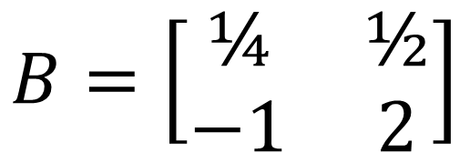
Old Basis: $\{\vec{e_{1}},\vec{e_{2}}\}$
New Basis: $\{\tilde{\vec{e_{1}}},\tilde{\vec{e_{2}}}\}$
$$\vec{e_{2}}$$
$$\vec{e_{1}}= \text{¼} \tilde{\vec{e_{1}}}+ \left(−\text{1}\right)\tilde{\vec{e_{2}}}$$
$$\tilde{\vec{e_{1}}}$$
$$\vec{e_{2}}= \text{½} \tilde{\vec{e_{1}}}+ \text{2} \tilde{\vec{e_{2}}}$$
$$\tilde{\vec{e_{2}}}$$
$$\vec{e_{1}}$$
$$B=\left[\begin{matrix}\text{¼} & \text{½} \\ −1 & \text{2}\end{matrix}\right]$$

Slide 12
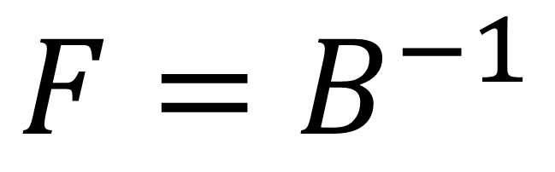
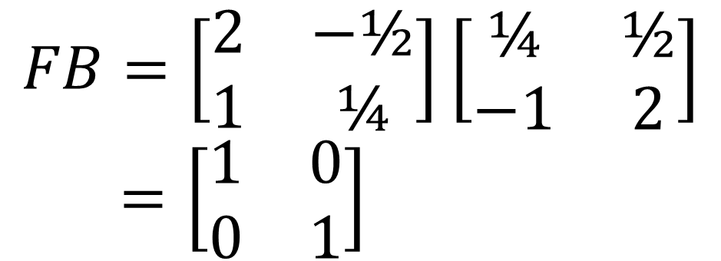
Old Basis: $\{\vec{e_{1}},\vec{e_{2}}\}$
New Basis: $\{\tilde{\vec{e_{1}}},\tilde{\vec{e_{2}}}\}$
$$FB=\left[\begin{matrix}2 & −\text{½} \\ 1 & \text{¼}\end{matrix}\right]\left[\begin{matrix}\text{¼} & \text{½} \\ −1 & \text{2}\end{matrix}\right] \\ =\left[\begin{matrix}1 & 0 \\ 0 & \text{1}\end{matrix}\right]$$
$$\vec{e_{2}}$$
$$\tilde{\vec{e_{1}}}$$
$$\tilde{\vec{e_{2}}}$$
$$F=B^{−1}$$
$$\vec{e_{1}}$$

Slide 13

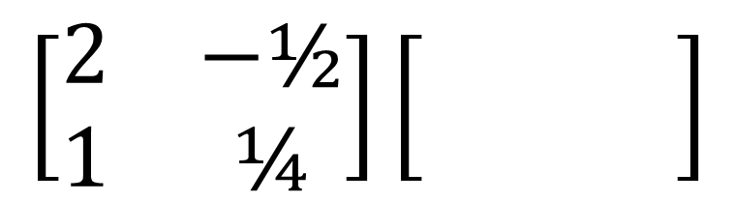
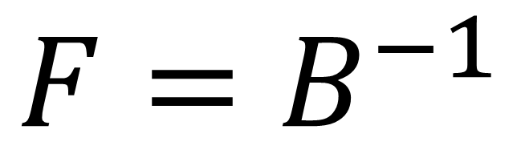
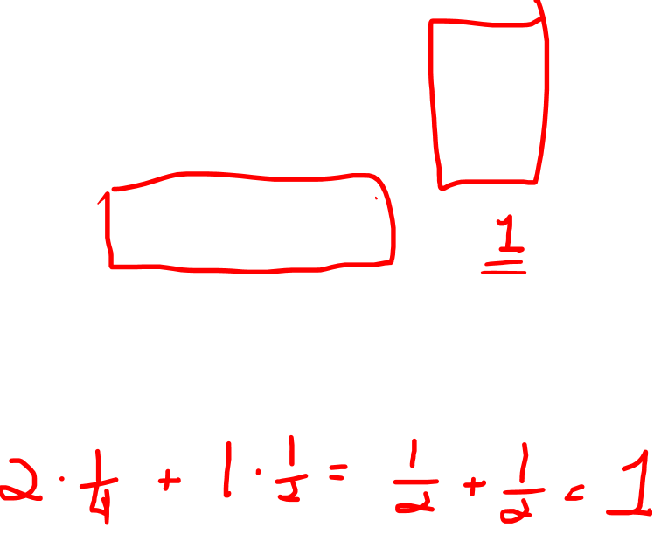
Old Basis: $\{\vec{e_{1}},\vec{e_{2}}\}$
New Basis: $\{\tilde{\vec{e_{1}}},\tilde{\vec{e_{2}}}\}$
$$FB=\left[\begin{matrix}2 & −\text{½} \\ 1 & \text{¼}\end{matrix}\right]\left[\begin{matrix}\text{¼} & \text{½} \\ −1 & \text{2}\end{matrix}\right] \\ =\left[\begin{matrix}1 & 0 \\ 0 & \text{1}\end{matrix}\right]$$
$$\vec{e_{2}}$$
$$\tilde{\vec{e_{1}}}$$
$$\left[\begin{matrix}\text{¼} & \text{½} \\ −1 & \text{2}\end{matrix}\right]$$
$$\tilde{\vec{e_{2}}}$$
$$F=B^{−1}$$
$$\left[\begin{matrix}2 & −\text{½} \\ 1 & \text{¼}\end{matrix}\right]\left[\begin{matrix} & \\ & \end{matrix}\right]$$
$$\vec{e_{1}}$$

Slide 14
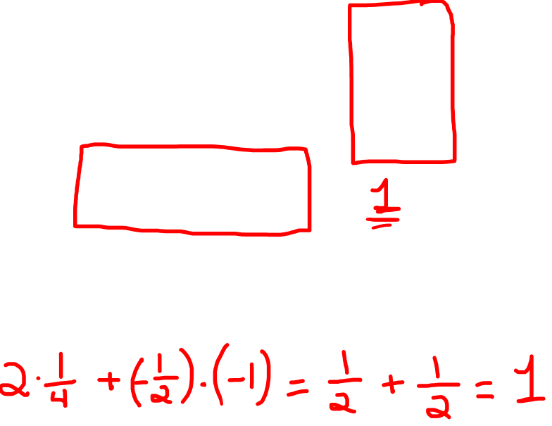
Old Basis: $\{\vec{e_{1}},\vec{e_{2}}\}$
New Basis: $\{\tilde{\vec{e_{1}}},\tilde{\vec{e_{2}}}\}$
$$FB=\left[\begin{matrix}2 & −\text{½} \\ 1 & \text{¼}\end{matrix}\right]\left[\begin{matrix}\text{¼} & \text{½} \\ −1 & \text{2}\end{matrix}\right] \\ =\left[\begin{matrix}1 & 0 \\ 0 & \text{1}\end{matrix}\right]$$
$$\vec{e_{2}}$$
$$\tilde{\vec{e_{1}}}$$
$$\left[\begin{matrix}\text{¼} & \text{½} \\ −1 & \text{2}\end{matrix}\right]$$
$$\tilde{\vec{e_{2}}}$$
$$F=B^{−1}$$
$$\left[\begin{matrix}2 & −\text{½} \\ 1 & \text{¼}\end{matrix}\right]\left[\begin{matrix} & \\ & \end{matrix}\right]$$
$$\vec{e_{1}}$$

Slide 15

Old Basis: $\{\vec{e_{1}},\vec{e_{2}}\}$
New Basis: $\{\tilde{\vec{e_{1}}},\tilde{\vec{e_{2}}}\}$
$$FB=\left[\begin{matrix}2 & −\text{½} \\ 1 & \text{¼}\end{matrix}\right]\left[\begin{matrix}\text{¼} & \text{½} \\ −1 & \text{2}\end{matrix}\right] \\ =\left[\begin{matrix}1 & 0 \\ 0 & \text{1}\end{matrix}\right]$$
$$\vec{e_{2}}$$
$$\tilde{\vec{e_{1}}}$$
$$\tilde{\vec{e_{2}}}$$
$$F=B^{−1}$$
$$\vec{e_{1}}$$

Slide 16
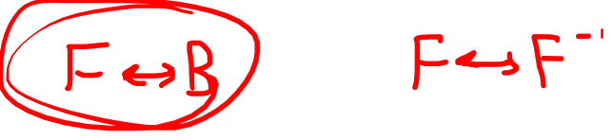
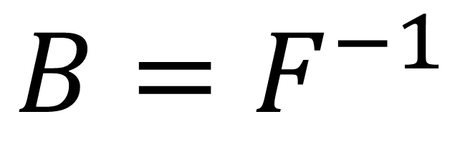
Old Basis: $\{\vec{e_{1}},\vec{e_{2}}\}$
New Basis: $\{\tilde{\vec{e_{1}}},\tilde{\vec{e_{2}}}\}$
$$FB=\left[\begin{matrix}2 & −\text{½} \\ 1 & \text{¼}\end{matrix}\right]\left[\begin{matrix}\text{¼} & \text{½} \\ −1 & \text{2}\end{matrix}\right] \\ =\left[\begin{matrix}1 & 0 \\ 0 & \text{1}\end{matrix}\right]$$
$$\vec{e_{2}}$$
$$\tilde{\vec{e_{1}}}$$
$$\tilde{\vec{e_{2}}}$$
$$B=F^{−1}$$
$$\vec{e_{1}}$$

Slide 17


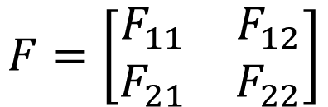
$$\tilde{\vec{e_{1}}}=F_{11}\vec{e_{1}}+F_{21}\vec{e_{2}}$$
$$F=\left[\begin{matrix}F_{11} & F_{12} \\ F_{21} & F_{22}\end{matrix}\right]$$
$$\tilde{\vec{e_{2}}}=F_{12}\vec{e_{1}}+F_{22}\vec{e_{2}}$$

Slide 18


$$\tilde{\vec{e_{1}}}=F_{11}\vec{e_{1}}+F_{21}\vec{e_{2}}$$
$$F=\left[\begin{matrix}F_{11} & F_{12} \\ F_{21} & F_{22}\end{matrix}\right]$$
$$\tilde{\vec{e_{2}}}=F_{12}\vec{e_{1}}+F_{22}\vec{e_{2}}$$
$$\tilde{\vec{e_{1}}}=F_{11}\vec{e_{1}}+F_{21}\vec{e_{2}}+…+F_{n1}\vec{e_{n}}$$
$$\tilde{\vec{e_{2}}}=F_{12}\vec{e_{1}}+F_{22}\vec{e_{2}}+…+F_{n2}\vec{e_{n}}$$
$$…$$
$$\tilde{\vec{e_{n}}}=F_{1n}\vec{e_{1}}+F_{2n}\vec{e_{2}}+…+F_{nn}\vec{e_{n}}$$

Slide 19
$$\tilde{\vec{e_{1}}}=F_{11}\vec{e_{1}}+F_{21}\vec{e_{2}}$$
$$F=\left[\begin{matrix}F_{11} & F_{12} \\ F_{21} & F_{22}\end{matrix}\right]$$
$$\tilde{\vec{e_{2}}}=F_{12}\vec{e_{1}}+F_{22}\vec{e_{2}}$$
$$\tilde{\vec{e_{1}}}=F_{11}\vec{e_{1}}+F_{21}\vec{e_{2}}+…+F_{n1}\vec{e_{n}}$$
$$\tilde{\vec{e_{2}}}=F_{12}\vec{e_{1}}+F_{22}\vec{e_{2}}+…+F_{n2}\vec{e_{n}}$$
$$\tilde{\vec{e_{n}}}=F_{1n}\vec{e_{1}}+F_{2n}\vec{e_{2}}+…+F_{nn}\vec{e_{n}}$$

Slide 20


$$\tilde{\vec{e_{1}}}=F_{11}\vec{e_{1}}+F_{21}\vec{e_{2}}$$
$$F=\left[\begin{matrix}F_{11} & F_{12} \\ F_{21} & F_{22}\end{matrix}\right]$$
$$\tilde{\vec{e_{2}}}=F_{12}\vec{e_{1}}+F_{22}\vec{e_{2}}$$
$$\tilde{\vec{e_{1}}}=F_{11}\vec{e_{1}}+F_{21}\vec{e_{2}}+…+F_{n1}\vec{e_{n}}$$
$$\left[\begin{matrix}\begin{matrix}F_{11} & F_{12} \\ F_{21} & F_{22}\end{matrix} & \begin{matrix}… & F_{1n} \\ … & F_{2n}\end{matrix} \\ \begin{matrix}⋮ & ⋮ \\ F_{n1} & F_{n2}\end{matrix} & \begin{matrix}⋱ & ⋮ \\ … & F_{nn} \end{matrix}\end{matrix}\right]$$
$$\tilde{\vec{e_{2}}}=F_{12}\vec{e_{1}}+F_{22}\vec{e_{2}}+…+F_{n2}\vec{e_{n}}$$
$$…$$
$$\tilde{\vec{e_{n}}}=F_{1n}\vec{e_{1}}+F_{2n}\vec{e_{2}}+…+F_{nn}\vec{e_{n}}$$

Slide 21

$$\tilde{\vec{e_{1}}}=F_{11}\vec{e_{1}}+F_{21}\vec{e_{2}}$$
$$F=\left[\begin{matrix}F_{11} & F_{12} \\ F_{21} & F_{22}\end{matrix}\right]$$
$$\tilde{\vec{e_{2}}}=F_{12}\vec{e_{1}}+F_{22}\vec{e_{2}}$$
$$\tilde{\vec{e_{1}}}=F_{11}\vec{e_{1}}+F_{21}\vec{e_{2}}+…+F_{n1}\vec{e_{n}}$$
$$\left[\begin{matrix}\begin{matrix}F_{11} & F_{12} \\ F_{21} & F_{22}\end{matrix} & \begin{matrix}… & F_{1n} \\ … & F_{2n}\end{matrix} \\ \begin{matrix}⋮ & ⋮ \\ F_{n1} & F_{n2}\end{matrix} & \begin{matrix}⋱ & ⋮ \\ … & F_{nn} \end{matrix}\end{matrix}\right]$$
$$\tilde{\vec{e_{2}}}=F_{12}\vec{e_{1}}+F_{22}\vec{e_{2}}+…+F_{n2}\vec{e_{n}}$$
$$…$$
$$\tilde{\vec{e_{n}}}=F_{1n}\vec{e_{1}}+F_{2n}\vec{e_{2}}+…+F_{nn}\vec{e_{n}}$$

Slide 22
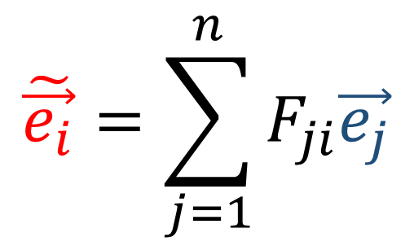
$$\tilde{\vec{e_{1}}}=F_{11}\vec{e_{1}}+F_{21}\vec{e_{2}}$$
$$F=\left[\begin{matrix}F_{11} & F_{12} \\ F_{21} & F_{22}\end{matrix}\right]$$
$$\tilde{\vec{e_{2}}}=F_{12}\vec{e_{1}}+F_{22}\vec{e_{2}}$$
$$\tilde{\vec{e_{1}}}=F_{11}\vec{e_{1}}+F_{21}\vec{e_{2}}+…+F_{n1}\vec{e_{n}}$$
$$\left[\begin{matrix}\begin{matrix}F_{11} & F_{12} \\ F_{21} & F_{22}\end{matrix} & \begin{matrix}… & F_{1n} \\ … & F_{2n}\end{matrix} \\ \begin{matrix}⋮ & ⋮ \\ F_{n1} & F_{n2}\end{matrix} & \begin{matrix}⋱ & ⋮ \\ … & F_{nn} \end{matrix}\end{matrix}\right]$$
$$\tilde{\vec{e_{2}}}=F_{12}\vec{e_{1}}+F_{22}\vec{e_{2}}+…+F_{n2}\vec{e_{n}}$$
$$…$$
$$\tilde{\vec{e_{n}}}=F_{1n}\vec{e_{1}}+F_{2n}\vec{e_{2}}+…+F_{nn}\vec{e_{n}}$$
$$\tilde{\vec{e_{i}}}=\sum_{j=1}^{n}{F_{ji}\vec{e_{j}}}$$

Slide 23


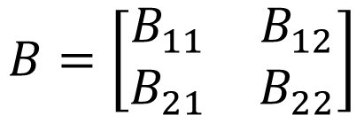
$$\vec{e_{1}}=B_{11}\tilde{\vec{e_{1}}}+B_{21}\tilde{\vec{e_{2}}}$$
$$B=\left[\begin{matrix}B_{11} & B_{12} \\ B_{21} & B_{22}\end{matrix}\right]$$
$$\vec{e_{2}}=B_{12}\tilde{\vec{e_{1}}}+B_{22}\tilde{\vec{e_{2}}}$$

Slide 24

$$\vec{e_{1}}=B_{11}\tilde{\vec{e_{1}}}+B_{21}\tilde{\vec{e_{2}}}$$
$$B=\left[\begin{matrix}B_{11} & B_{12} \\ B_{21} & B_{22}\end{matrix}\right]$$
$$\vec{e_{2}}=B_{12}\tilde{\vec{e_{1}}}+B_{22}\tilde{\vec{e_{2}}}$$
$$\vec{e_{1}}=B_{11}\tilde{\vec{e_{1}}}+B_{21}\tilde{\vec{e_{2}}}+…+B_{n1}\tilde{\vec{e_{n}}}$$
$$\left[\begin{matrix}\begin{matrix}B_{11} & B_{12} \\ B_{21} & B_{22}\end{matrix} & \begin{matrix}… & B_{1n} \\ … & B_{2n}\end{matrix} \\ \begin{matrix}⋮ & ⋮ \\ B_{n1} & B_{n2}\end{matrix} & \begin{matrix}⋱ & ⋮ \\ … & B_{nn} \end{matrix}\end{matrix}\right]$$
$$\vec{e_{2}}=B_{12}\tilde{\vec{e_{1}}}+B_{22}\tilde{\vec{e_{2}}}+…+B_{n2}\tilde{\vec{e_{n}}}$$
$$…$$
$$\vec{e_{n}}=B_{1n}\tilde{\vec{e_{1}}}+B_{2n}\tilde{\vec{e_{2}}}+…+B_{nn}\tilde{\vec{e_{n}}}$$

Slide 25
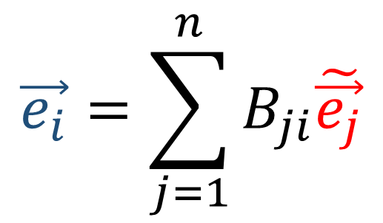
$$\vec{e_{1}}=B_{11}\tilde{\vec{e_{1}}}+B_{21}\tilde{\vec{e_{2}}}$$
$$B=\left[\begin{matrix}B_{11} & B_{12} \\ B_{21} & B_{22}\end{matrix}\right]$$
$$\vec{e_{2}}=B_{12}\tilde{\vec{e_{1}}}+B_{22}\tilde{\vec{e_{2}}}$$
$$\vec{e_{1}}=B_{11}\tilde{\vec{e_{1}}}+B_{21}\tilde{\vec{e_{2}}}+…+B_{n1}\tilde{\vec{e_{n}}}$$
$$\left[\begin{matrix}\begin{matrix}B_{11} & B_{12} \\ B_{21} & B_{22}\end{matrix} & \begin{matrix}… & B_{1n} \\ … & B_{2n}\end{matrix} \\ \begin{matrix}⋮ & ⋮ \\ B_{n1} & B_{n2}\end{matrix} & \begin{matrix}⋱ & ⋮ \\ … & B_{nn} \end{matrix}\end{matrix}\right]$$
$$\vec{e_{2}}=B_{12}\tilde{\vec{e_{1}}}+B_{22}\tilde{\vec{e_{2}}}+…+B_{n2}\tilde{\vec{e_{n}}}$$
$$…$$
$$\vec{e_{n}}=B_{1n}\tilde{\vec{e_{1}}}+B_{2n}\tilde{\vec{e_{2}}}+…+B_{nn}\tilde{\vec{e_{n}}}$$
$$\vec{e_{i}}=\sum_{j=1}^{n}{B_{ji}\tilde{\vec{e_{j}}}}$$

Slide 26


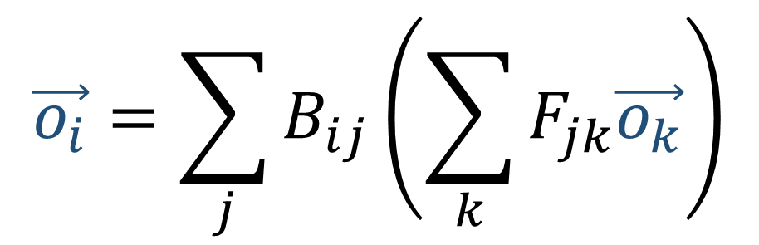

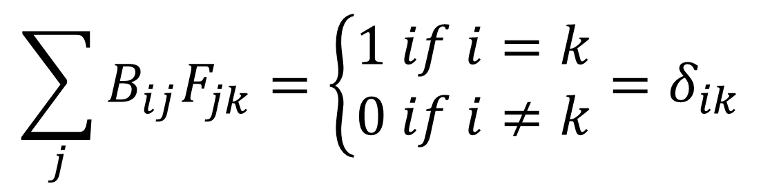
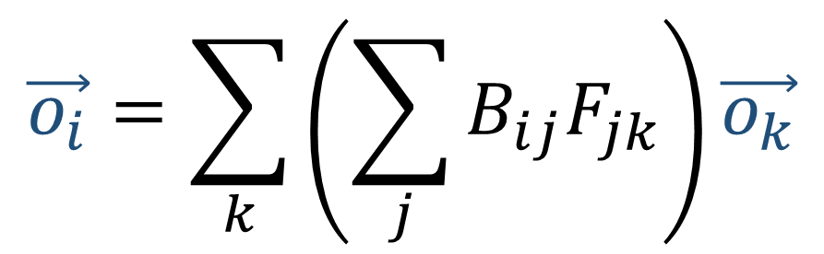
$$\vec{o_{i}}=\sum_{j}{B_{ij}\vec{n_{j}}}$$
$$\tilde{\vec{e_{j}}}=\sum_{k=1}^{n}{F_{kj}\vec{e_{k}}}$$
$$\vec{o_{i}}=\sum_{j}{B_{ij}\left(\sum_{k}{F_{jk}\vec{o_{k}}}\right)}$$
$$\vec{e_{i}}=\sum_{j=1}^{n}{B_{ji}\tilde{\vec{e_{j}}}}$$
$$\vec{o_{i}}=\sum_{k}{\left(\sum_{j}{B_{ij}F_{jk}}\right)\vec{o_{k}}}$$
$$\sum_{j}{B_{ij}F_{jk}}=\left\{\begin{aligned}1 if i=k \\ 0 if i≠k\end{aligned}\right.=δ_{ik}$$

Slide 27

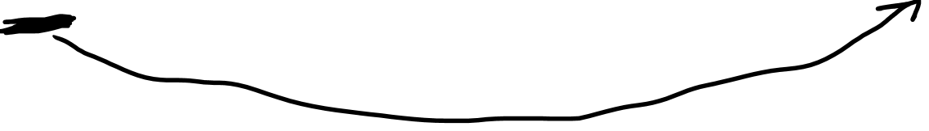
$$\vec{o_{i}}=\sum_{j}{B_{ij}\vec{n_{j}}}$$
$$\tilde{\vec{e_{j}}}=\sum_{k=1}^{n}{F_{kj}\vec{e_{k}}}$$
$$\vec{e_{i}}=\sum_{j=1}^{n}{B_{ji}\tilde{\vec{e_{j}}}}$$
$$\vec{o_{i}}=\sum_{j}{B_{ij}\left(\sum_{k}{F_{jk}\vec{o_{k}}}\right)}$$
$$\vec{e_{i}}=\sum_{j=1}^{n}{B_{ji}\tilde{\vec{e_{j}}}}$$
$$\vec{o_{i}}=\sum_{k}{\left(\sum_{j}{B_{ij}F_{jk}}\right)\vec{o_{k}}}$$
$$\sum_{j}{B_{ij}F_{jk}}=\left\{\begin{aligned}1 if i=k \\ 0 if i≠k\end{aligned}\right.=δ_{ik}$$

Slide 28
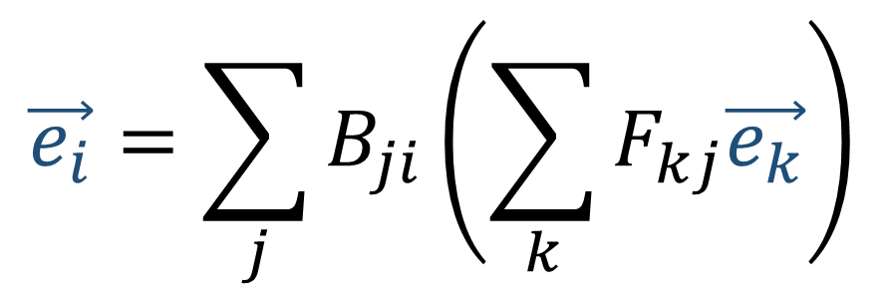

$$\vec{o_{i}}=\sum_{j}{B_{ij}\vec{n_{j}}}$$
$$\tilde{\vec{e_{j}}}=\sum_{k=1}^{n}{F_{kj}\vec{e_{k}}}$$
$$\vec{e_{i}}=\sum_{j=1}^{n}{B_{ji}\tilde{\vec{e_{j}}}}$$
$$\vec{o_{i}}=\sum_{j}{B_{ij}\left(\sum_{k}{F_{jk}\vec{o_{k}}}\right)}$$
$$\vec{e_{i}}=\sum_{j=1}^{n}{B_{ji}\tilde{\vec{e_{j}}}}$$
$$\vec{e_{i}}=\sum_{j}{B_{ji}\left(\sum_{k}{F_{kj}\vec{e_{k}}}\right)}$$
$$\vec{o_{i}}=\sum_{k}{\left(\sum_{j}{B_{ij}F_{jk}}\right)\vec{o_{k}}}$$
$$\sum_{j}{B_{ij}F_{jk}}=\left\{\begin{aligned}1 if i=k \\ 0 if i≠k\end{aligned}\right.=δ_{ik}$$

Slide 29

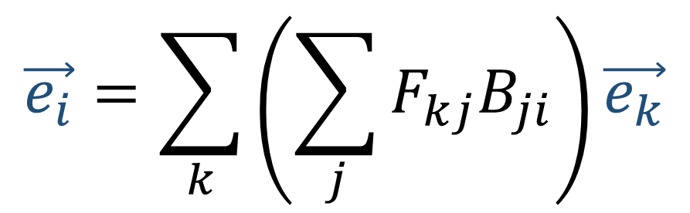
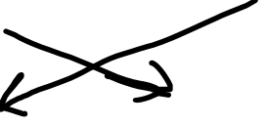
$$\vec{o_{i}}=\sum_{j}{B_{ij}\vec{n_{j}}}$$
$$\tilde{\vec{e_{j}}}=\sum_{k=1}^{n}{F_{kj}\vec{e_{k}}}$$
$$\vec{e_{i}}=\sum_{j=1}^{n}{B_{ji}\tilde{\vec{e_{j}}}}$$
$$\vec{o_{i}}=\sum_{j}{B_{ij}\left(\sum_{k}{F_{jk}\vec{o_{k}}}\right)}$$
$$\vec{e_{i}}=\sum_{j=1}^{n}{B_{ji}\tilde{\vec{e_{j}}}}$$
$$\vec{e_{i}}=\sum_{j}{B_{ji}\left(\sum_{k}{F_{kj}\vec{e_{k}}}\right)}$$
$$\vec{o_{i}}=\sum_{k}{\left(\sum_{j}{B_{ij}F_{jk}}\right)\vec{o_{k}}}$$
$$\vec{e_{i}}=\sum_{k}{\left(\sum_{j}{F_{kj}B_{ji}}\right)\vec{e_{k}}}$$
$$\sum_{j}{B_{ij}F_{jk}}=\left\{\begin{aligned}1 if i=k \\ 0 if i≠k\end{aligned}\right.=δ_{ik}$$

Slide 30


$$\vec{e_{i}}=\sum_{k}{\left(\sum_{j}{F_{kj}B_{ji}}\right)\vec{e_{k}}}$$

Slide 31


$$\vec{e_{i}}=\sum_{k}{\left(\sum_{j}{F_{kj}B_{ji}}\right)\vec{e_{k}}}$$
$$\vec{e_{1}}=\vec{e_{1}} \\ \vec{e_{2}}=\vec{e_{2}}$$ $⋮$ $$\vec{e_{n}}=\vec{e_{n}}$$

Slide 32


$$\vec{e_{i}}=\sum_{k}{\left(\sum_{j}{F_{kj}B_{ji}}\right)\vec{e_{k}}}$$
$$\vec{e_{1}}=\vec{e_{1}} \\ \vec{e_{2}}=\vec{e_{2}}$$ $⋮$ $$\vec{e_{n}}=\vec{e_{n}}$$
$$\sum_{j}{F_{kj}B_{ji}}=\left\{\begin{aligned}1 if i=k \\ 0 if i≠k\end{aligned}\right.$$

Slide 33


$$\vec{e_{i}}=\sum_{k}{\left(\sum_{j}{F_{kj}B_{ji}}\right)\vec{e_{k}}}$$
$$\vec{e_{1}}=\vec{e_{1}} \\ \vec{e_{2}}=\vec{e_{2}}$$ $⋮$ $$\vec{e_{n}}=\vec{e_{n}}$$
$$\sum_{j}{F_{kj}B_{ji}}=\left\{\begin{aligned}1 if i=k \\ 0 if i≠k\end{aligned}\right.$$
$$δ_{ik}=\left\{\begin{aligned}1 if i=k \\ 0 if i≠k\end{aligned}\right.$$

Slide 34




$$\tilde{\vec{e_{j}}}=\sum_{k=1}^{n}{F_{kj}\vec{e_{k}}}$$
$$\sum_{j}{F_{kj}B_{ji}}=δ_{ik}=\left\{\begin{aligned}1 if i=k \\ 0 if i≠k\end{aligned}\right.$$
$$\vec{e_{i}}=\sum_{j=1}^{n}{B_{ji}\tilde{\vec{e_{j}}}}$$

